Slide 1
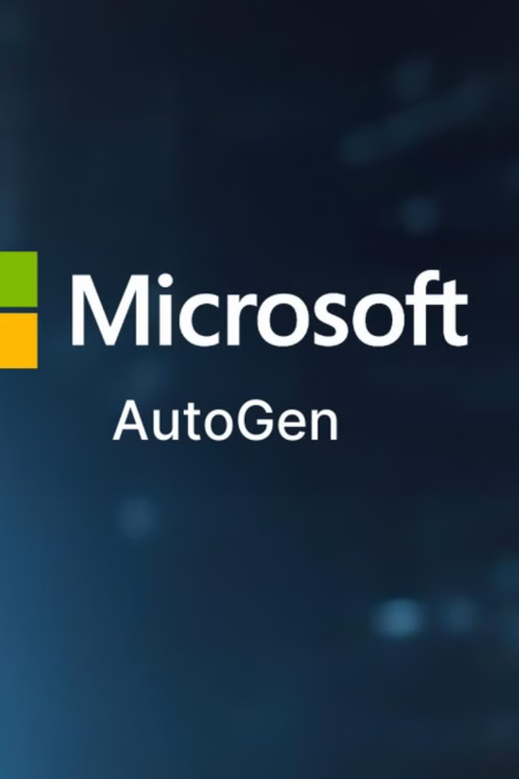
Autogen: The Future of Automated Generation
Welcome to the world of Autogen, where the lines between human and machine creativity blur. Join us as we explore the transformative potential of automated generation across various fields.

Slide 2
Understanding Autogen: Definitions and Scope
What is Autogen?
Autogen encompasses a wide range of technologies that leverage machine learning to generate content, code, and even entire systems automatically. Think of it as a digital creative assistant that can assist in brainstorming, writing, designing, and more.

Slide 3
Features:
It offers features such as agents that can converse with other agents, LLM and tool use support, autonomous and human-in-the-loop workflows, and multi-agent conversation patterns.
AutoGen enables building next-gen LLM applications based on multi-agent conversations with minimal effort. It simplifies the orchestration, automation, and optimization of a complex LLM workflow. It maximizes the performance of LLM models and overcomes their weaknesses.
It supports diverse conversation patterns for complex workflows. With customizable and conversable agents, developers can use AutoGen to build a wide range of conversation patterns concerning conversation autonomy, the number of agents, and agent conversation topology.
It provides a collection of working systems with different complexities. These systems span a wide range of applications from various domains and complexities. This demonstrates how AutoGen can easily support diverse conversation patterns.
LLMs have limitations, such as:
Struggles with long-term memory.
Inefficiency in multi-step reasoning or decomposition of complex tasks.
Difficulty in generating self-correcting responses.
AutoGen agents are specialized to address these:
Task Decomposition: A planning agent can break down a complex task into simpler sub-tasks for others to handle.
Verification and Debugging: A critic or reviewer agent evaluates outputs, identifies errors, and suggests fixes to ensure correctness.
Iterative Feedback Loops: Agents continuously refine outputs based on peer feedback, improving the overall quality.

Slide 4
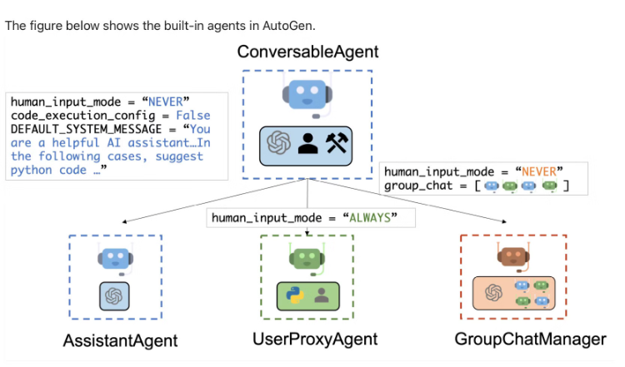
AGENTS:
Conversable: Agents in AutoGen are conversable, which means that any agent can send and receive messages from other agents to initiate or continue a conversation
Customizable: Agents in AutoGen can be customized to integrate LLMs, humans, tools, or a combination of them.
The AssistantAgent is designed to act as an AI assistant, using LLMs by default but not requiring human input or code execution.It could write Python code for a user to execute when a message is received. Under the hood, the Python code is written by LLM (e.g., GPT-4).
The UserProxyAgent is conceptually a proxy agent for humans, soliciting human input as the agent's reply at each interaction turn by default and also having the capability to execute code and call functions or tools

Slide 5
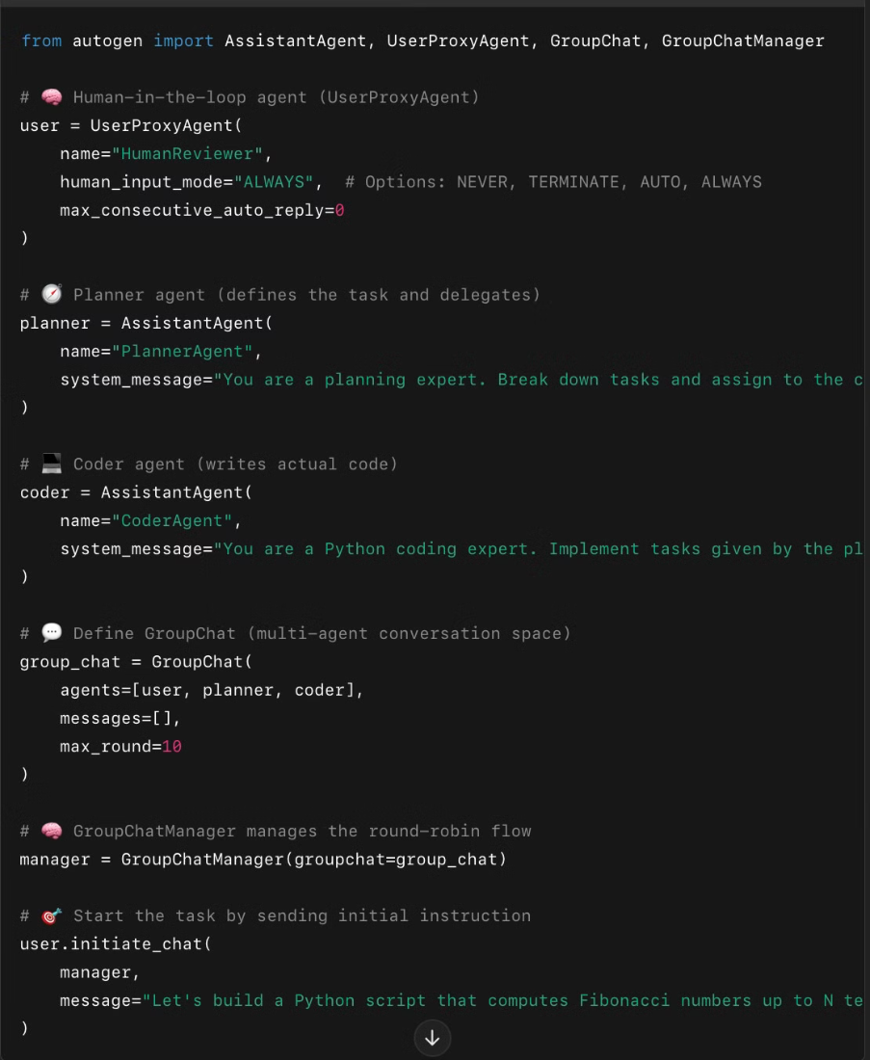
MULTI-AGENT CHAT:

Slide 6
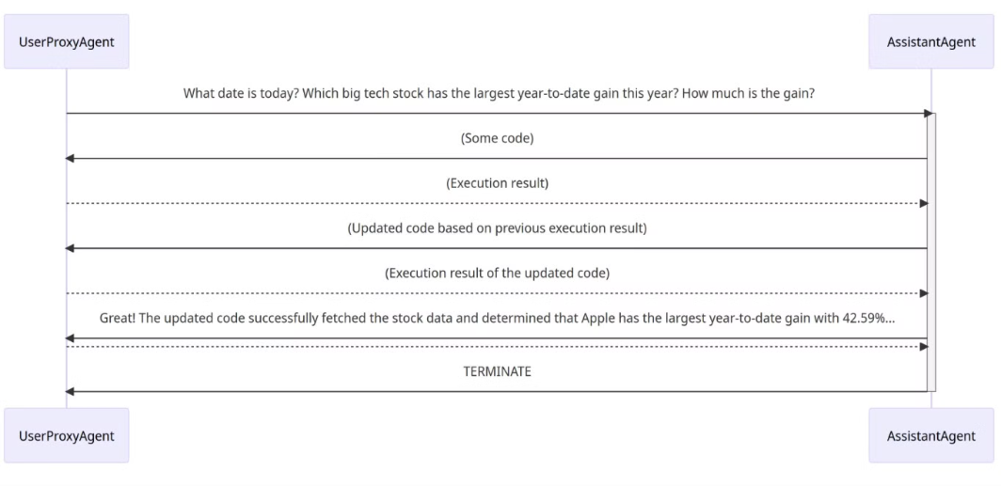
A Basic Two-Agent Conversation Example
The assistant receives a message from the user_proxy, which contains the task description.
The assistant then tries to write Python code to solve the task and sends the response to the user_proxy.
Once the user_proxy receives a response from the assistant, it tries to reply by either soliciting human input or preparing an automatically generated reply. If no human input is provided, the user_proxy executes the code and uses the result as the auto-reply.
The assistant then generates a further response for the user_proxy. The user_proxy can then decide whether to terminate the conversation. If not, steps 3 and 4 are repeated.

Slide 7
How Does AutoGen Generate Content?
Agent Roles and Prompts
Each agent is powered by an LLM (like GPT-4 or Claude) and is given a role + instructions (prompt). For example:
UserProxyAgent: represents the human user. AssistantAgent: generates content based on instructions. CriticAgent: reviews and gives feedback. These agents communicate through structured conversations.
Conversation Loops
AutoGen enables multi-turn, multi-agent conversations. For example:
The user gives a prompt via UserProxyAgent. AssistantAgent responds with generated content (e.g., code, essay, plan). CriticAgent may evaluate and suggest improvements. The loop continues until a final version is accepted. This multi-agent feedback loop leads to better content generation than single-shot prompting.
LLM API Calls
Each agent uses an underlying LLM API (e.g., OpenAI GPT-4 API). AutoGen controls the formatting of messages, roles, memory, etc., but the content generation still happens through the LLM.
Custom Logic
You can inject custom stopping criteria, validation functions, tools, or external APIs into the workflow to guide the generation and make it more dynamic and task-specific.

Slide 8
Static and dynamic conversations
AutoGen inherently supports dynamic conversations. This dynamic nature allows the agent topology to adapt based on the actual conversation flow under varying input problem scenarios. Conversely, static conversations adhere to a predefined topology. Dynamic conversations are particularly beneficial in complex settings where interaction patterns cannot be predetermined.
Registered auto-reply
With the pluggable auto-reply function, one can choose to invoke conversations with other agents depending on the content of the current message and context. For example:
Hierarchical chat like in OptiGuide.
Dynamic Group Chat which is a special form of hierarchical chat. In the system, we register a reply function in the group chat manager, which broadcasts messages and decides who the next speaker will be in a group chat setting.
Finite State Machine graphs to set speaker transition constraints which is a special form of dynamic group chat. In this approach, a directed transition matrix is fed into group chat. Users can specify legal transitions or specify disallowed transitions.
Nested chat like in conversational chess.
LLM-Based Function Call:
Another approach involves LLM-based function calls, where LLM decides if a specific function should be invoked based on the conversation's status during each inference. This approach enables dynamic multi-agent conversations, as seen in scenarios like multi-user math problem solving scenario, where a student assistant automatically seeks expertise via function calls.

Slide 9
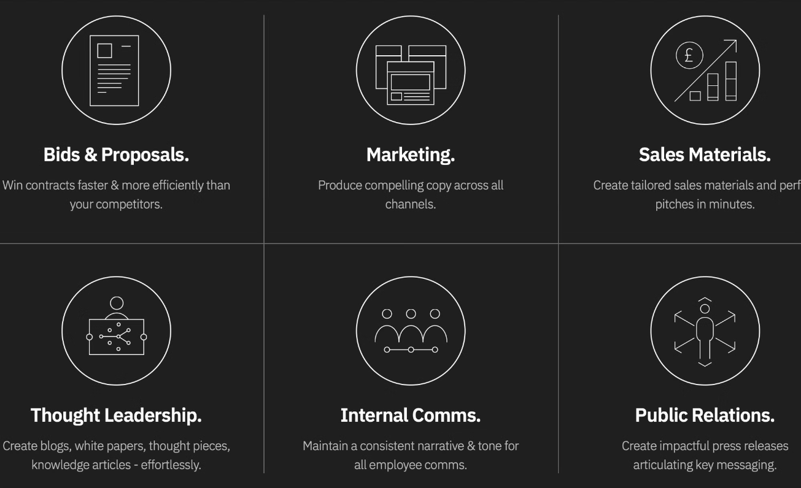
Use cases:

Slide 10
Domain
Use Cases
Applications
NLP
- Automated content creation for blogs and emails
- AI writing tools (Grammarly, Jasper)
- Chatbots for customer support
- Gmail Smart Compose
- Legal and financial report summarization
- AI-based legal tech platforms
Computer Vision
- Synthetic data generation for model training
- Autonomous vehicle perception systems
- AI-powered graphic design
- E-commerce image generation
- Virtual try-ons in fashion
- Marketing campaigns automation
E-Commerce
- Auto-generated product descriptions
- Amazon, Flipkart
- Personalized product recommendations
- HubSpot, Salesforce
- Automated dynamic pricing
- Recommendation engines
Healthcare
- Auto-generated patient reports
- EHR systems (Epic, Cerner)
- Clinical note summarization
- IBM Watson Health
- Personalized treatment recommendations
- Telemedicine platforms
Finance
- Auto-generated financial reports
- Wealthfront
- Fraud detection with AI alerts
- Banking chatbots (Erica)
- Investment portfolio recommendations
- Risk assessment tools
Entertainment
- AI-driven scriptwriting
- Video game development (Unity, Unreal Engine)
- Dynamic story generation
- Content streaming (Netflix AI-powered trailers)
- Music generation
- AI music creators (AIVA)
Education
- Auto-generated quizzes and assessments
- Coursera, Khan Academy
- Personalized learning material
- Duolingo AI-driven content
- Real-time tutoring
- AI tutors
Marketing
- Automated ad copy creation
- Copy.ai
- Personalized social media content
- Mailchimp
- AI-powered SEO content suggestions
- Meta, LinkedIn
Legal
- Automated contract drafting
- DocuSign
- Compliance report generation
- LegalZoom AI-driven tools
- Legal document analysis
- Regulatory compliance solutions
Gaming
- Auto-generation of game levels and worlds
- Unity, Unreal Engine
- AI-driven NPC interactions
- AI Dungeon
- Personalized in-game content
- Procedural game content

Slide 11
TOOLS:
Tool use is currently only available for LLMs that support OpenAI-compatible tool call API.
Tools are pre-defined functions that agents can use. Instead of writing arbitrary code, agents can call tools to perform actions, such as searching the web, performing calculations, reading files, or calling remote APIs. Because you can control what tools are available to an agent, you can control what actions an agent can perform.
Category
Best Compatible Tool
Reason for Compatibility
Large Language Models
GPT (OpenAI)
Highly adaptable APIs, strong NLP capabilities, and broad third-party integration support
Knowledge Integration
LangChain
Built specifically for integrating LLMs with external data sources and memory management
Memory Management
Pinecone
Scalable and fast vector database with excellent API integration for storing embeddings
Text-to-Image Generation
DALL-E
Native compatibility with OpenAI AutoGen systems
Speech Processing
Whisper (OpenAI)
Superior accuracy for multi-language speech recognition and native integration
Data Processing
Pandas
Seamless integration with Python-based AI models used in AutoGen
API Integration
REST APIs
Universal compatibility for fetching and pushing data in real-time
Prompt Engineering
Prompt Layer
Effective tracking, testing, and optimization of prompts across AutoGen models
Model Training
PyTorch
Strong industry support and compatibility with custom AI model deployment
Deployment Platform
AWS
High flexibility and services specifically designed for AI application hosting
Workflow Automation
Apache Airflow
Reliable and scalable automation pipeline for AutoGen tasks
Content Evaluation Tools
ROUGE
Widely accepted for natural language text evaluation
Version Control
GitHub
Best-in-class for collaborative development and seamless deployment pipelines

Slide 12
Which Tool Has the Best Compatibility with Microsoft AutoGen?
Azure Cognitive Services is the most compatible tool with Microsoft AutoGen, as it provides out-of-the-box integration with various AI services, including natural language processing, speech recognition, and computer vision, which are essential for building effective AI-driven solutions.
Microsoft Power Virtual Agents also pairs well, especially for building conversational AI applications, such as chatbots and virtual assistants, powered by AutoGen.

Slide 13
Tools Usage:
Similar to code executors, a tool must be registered with at least two agents for it to be useful in conversation.
The agent registered with the tool’s signature through register_for_llm can call the tool; the agent registered with the tool’s function object through register_for_execution can execute the tool’s function.
however,Sometimes it is preferable to hide the tool usage inside a single agent, i.e., the tool call and tool response messages are kept invisible from outside of the agent, and the agent responds to outside messages with tool usages as “internal monologues”.
For example, you might want build an agent that is similar to the OpenAI’s Assistant which executes built-in tools internally.
To achieve this, you can use nested chats. Nested chats allow you to create “internal monologues” within an agent to call and execute tools. This works for code execution as well.

Slide 14
Database Selection Considerations for AutoGen:
For Large-Scale, Real-Time Interaction:
Vector Databases like Pinecone and Weaviate are perfect for AI models requiring fast, high-dimensional search for context and conversation memory.
For Storing AI-generated Content:
Document Stores such as Elasticsearch are great for indexing and retrieving text-based outputs from AI systems.
For Fast Querying and High Availability:
NoSQL Databases like MongoDB and DynamoDB are suited for flexible, high-velocity data operations, especially when handling diverse data types.
For Structured Data Management:
Relational Databases (e.g., PostgreSQL, MySQL) are still relevant for business use cases requiring transactional data integrity.

Slide 15
Security Measures in AutoGen:
Data Encryption:
In-Transit Encryption: AutoGen platforms typically encrypt all data while in transit using HTTPS (SSL/TLS), ensuring that data is protected from man-in-the-middle attacks.
At-Rest Encryption: For data stored on servers, AutoGen platforms often use encryption mechanisms (e.g., AES-256) to protect sensitive data from unauthorized access.
Access Control:
Role-Based Access Control (RBAC): Systems often employ RBAC to ensure that only authorized users or systems can access specific datasets or API endpoints.
Authentication & Authorization: AutoGen may integrate with identity providers for secure authentication (e.g., OAuth, SSO) and to enforce fine-grained authorization policies.
Audit Logs:
Many AutoGen platforms generate audit logs for tracking data access and modifications. This ensures that any unusual activity is quickly identified.
Data Anonymization:
In some cases, platforms may anonymize or tokenize user data to minimize risks associated with sensitive information, especially when the platform generates or processes content on behalf of users.
Conclusion
For large enterprises with security concerns, AutoGen should be deployed in a controlled environment, with private LLM hosting, access control, and encryption mechanisms in place.

Slide 16
Data Compliance (GDPR, CCPA, HIPAA, etc.):
AutoGen platforms need to comply with various data protection and privacy regulations, particularly in healthcare, finance, or any domain handling sensitive information. Here are common regulatory frameworks AutoGen platforms follow:
GDPR (General Data Protection Regulation):
Platforms targeting EU residents need to comply with GDPR, which includes data rights (right to access, rectification, erasure), data breach notifications, and consent management.
Data Localization: Some platforms may provide features like data localization to ensure that user data stays within the region (i.e., EU servers for EU data).
CCPA (California Consumer Privacy Act):
Platforms that serve California residents must ensure they comply with CCPA, which includes providing users with rights to know what personal data is collected, request deletions, and opt-out of data sales.
HIPAA (Health Insurance Portability and Accountability Act):
In healthcare applications, AutoGen platforms may need to adhere to HIPAA to ensure the security of Protected Health Information (PHI) and safeguard sensitive medical data.
SOC 2 Compliance:
Some AutoGen platforms achieve SOC 2 Type II certification, which verifies that the platform meets rigorous security standards in five key areas: security, availability, processing integrity, confidentiality, and privacy.

Slide 17
Data Storage & User Privacy:
Regarding the concern of whether AutoGen uploads and stores your data on its servers:
Local Processing:
Many AutoGen platforms process data locally on the user’s device or within the application, ensuring that data does not leave the user’s system unless explicitly uploaded to the platform.
Data Storage on Servers:
In cases where data needs to be processed or stored in the cloud (for example, when training models or maintaining memory across interactions), AutoGen platforms may store data on their servers. However, most reputable platforms have mechanisms in place to protect your data through:
End-to-End Encryption so data is secure while being processed and stored.
Data Retention Policies that dictate how long data is kept and when it is deleted. Users are often given control over data deletion after processing.
Anonymization and Aggregation where sensitive data is anonymized or aggregated to ensure that personal information is not exposed during processing.
User Data Control:
Some AutoGen platforms provide user controls to allow users to manage what data is uploaded and to request deletion after a certain period, ensuring compliance with data privacy laws.

Slide 18
Key Features of AutoGen AI Platforms:
Feature
Description
Benefits
Customizable Prompt Templates
Users can create and store custom prompts to guide AI-generated responses.
Streamlines repetitive tasks and ensures consistency in responses across interactions.
Dynamic Content Generation
Auto-generates dynamic content (text, images, code) based on user input.
Saves time and resources by automating content creation in various formats like blog posts, marketing copy, etc.
Multi-turn Conversations
Supports context-based conversations, remembering previous interactions and adjusting responses accordingly.
Enhances user engagement and personalization for customer service or virtual assistant applications.
Integration with APIs & Databases
Can integrate with external systems like knowledge bases, CRMs, and databases for dynamic data retrieval.
Facilitates real-time data processing and enables advanced use cases such as product recommendations, etc.
Real-time Analytics & Insights
Provides analytics on interactions, user behavior, and content performance.
Helps users make data-driven decisions for improving content or user experience.
Speech Recognition & Synthesis
Converts speech to text and generates text-to-speech, enabling voice-based interfaces.
Ideal for creating voice assistants or interactive voice response (IVR) systems.
Content Personalization
Tailors generated content based on user profiles, preferences, or behaviors.
Enhances customer experience by delivering highly personalized and relevant content.
Scalability
Ability to scale AI models to handle larger volumes of data or interactions.
Perfect for businesses that need to scale up operations without compromising performance.

Slide 19
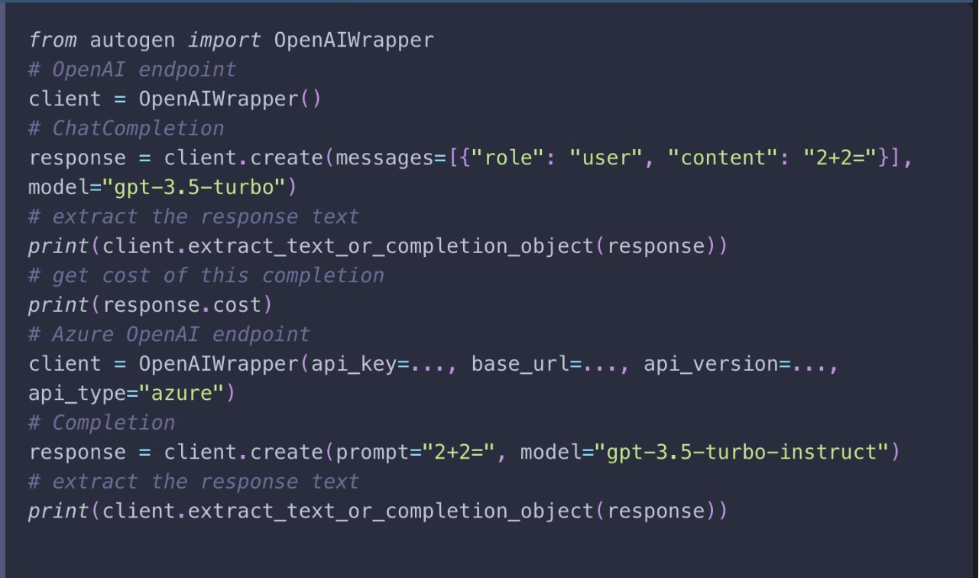
API unification
autogen.OpenAIWrapper.create() can be used to create completions for both chat and non-chat models, and both OpenAI API and Azure OpenAI API.

Slide 20
LLM Caching
AutoGen supports caching API requests so that they can be reused when the same request is issued. This is useful when repeating or continuing experiments for reproducibility and cost saving.

Slide 21
Difference between cache_seed and OpenAI's seed parameter:
OpenAI v1.1 introduced a new parameter seed. The difference between AutoGen's cache_seedand OpenAI's seed is AutoGen uses an explicit request cache to guarantee the exactly same output is produced for the same input and when cache is hit, no OpenAI API call will be made. OpenAI's seed is a best-effort deterministic sampling with no guarantee of determinism. When using OpenAI's seed with cache_seed set to None, even for the same input, an OpenAI API call will be made and there is no guarantee for getting exactly the same output.

Slide 22
Error handling
Runtime error
One can pass a list of configurations of different models/endpoints to mitigate the rate limits and other runtime error.
Logic error
Another type of error is that the returned response does not satisfy a requirement. For example, if the response is required to be a valid json string, one would like to filter the responses that are not. This can be achieved by providing a list of configurations and a filter function.

Slide 23
Agent Backed by OpenAI Assistant API:
Key Features of the GPTAssistantAgent:
Multi-Tool Mastery: Agents can leverage a combination of OpenAI's built-in tools, like Code Interpreter and File Search, alongside custom tools you create or integrate via Function Calling.
Streamlined Conversation Management: Benefit from persistent threads that automatically store message history and adjust based on the model's context length. This simplifies development by allowing you to focus on adding new messages rather than managing conversation flow.
File Access and Integration: Enable agents to access and utilize files in various formats. Files can be incorporated during agent creation or throughout conversations via threads. Additionally, agents can generate files (e.g., images, spreadsheets) and cite referenced files within their responses.
For a practical illustration, here are some examples:
Chat with OpenAI Assistant using function call demonstrates how to leverage function calling to enable intelligent function selection.
GPTAssistant with Code Interpreter showcases the integration of the Code Interpreter tool which executes Python code dynamically within applications.
Group Chat with GPTAssistantAgent demonstrates how to use the GPTAssistantAgent in AutoGen's group chat mode, enabling collaborative task performance through automated chat with agents powered by LLMs, tools, or humans.

Slide 24
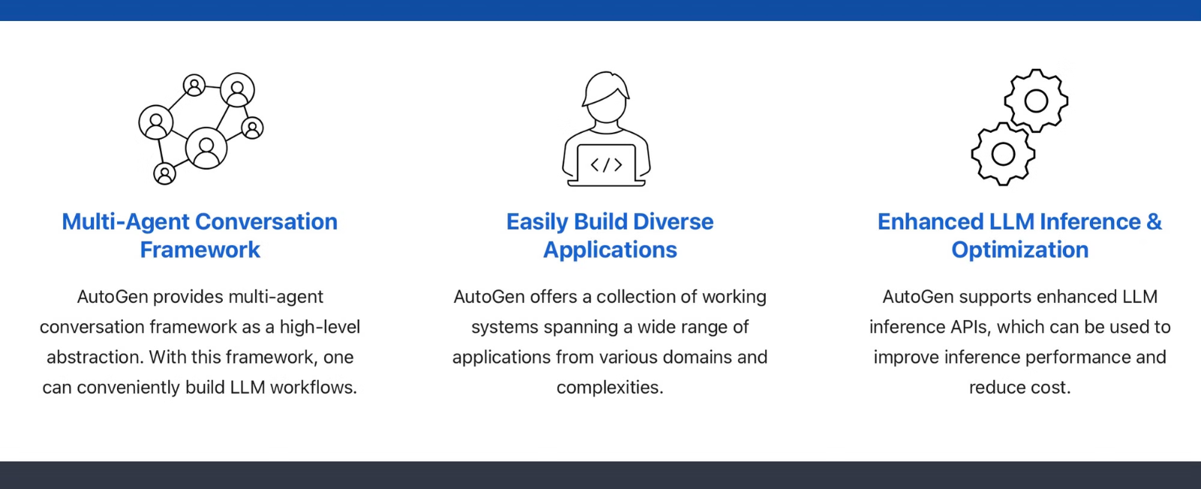

Slide 25

Built in Agents:

Slide 26
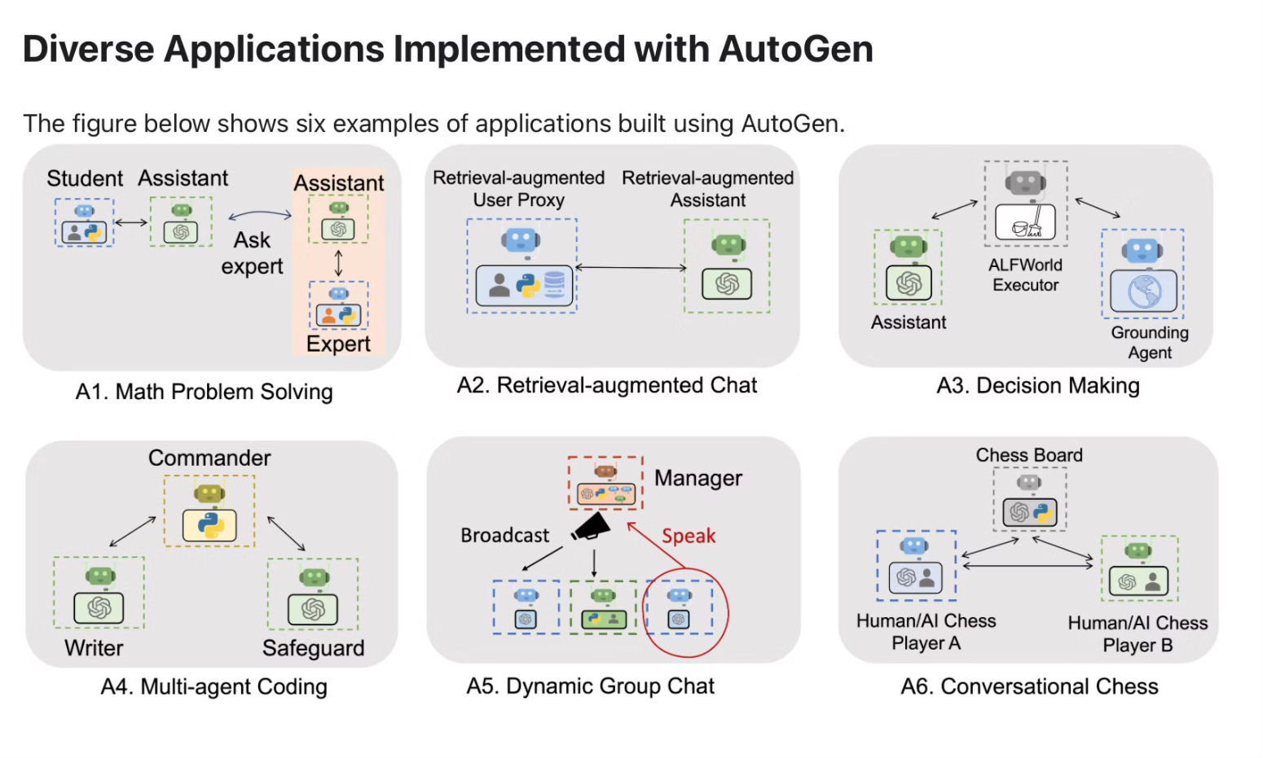

Slide 27
What are Multi-Agent Chatbots?
Multi-agent chatbots are AI systems where several specialized agents work together to complete tasks or manage complex conversations. Each agent focuses on a specific role, such as answering questions, providing recommendations, or analyzing data. This division of expertise allows the chatbot system to respond more accurately and efficiently. By coordinating with multiple agents, the chatbot can deliver more versatile and in-depth responses compared to a single-agent system.
Multi-agent chatbots are ideal for complex environments like customer service, e-commerce, and education. Each agent can take on a different function, such as handling returns, making product suggestions, or assisting with learning materials. When done right, multi-agent chatbots provide a smoother, faster, and more tailored user experience.

Slide 28
What are Conversation Patterns in Autogen?
To coordinate multi-agent conversations, AutoGen has the following conversation patterns that involve more than two agents.
Sequential Chat: This involves a series of conversations between two agents, each linked to the next. A carryover mechanism brings a summary of the prior chat into the context of the following one.
Group Chat: This is a single conversation that includes more than two agents. A key consideration is deciding which agent should respond next, and AutoGen offers multiple ways to organize agent interactions to fit various scenarios.
Nested Chat: Nested chat involves packaging a workflow into a single agent, allowing it to be reused within a larger workflow.

Slide 29
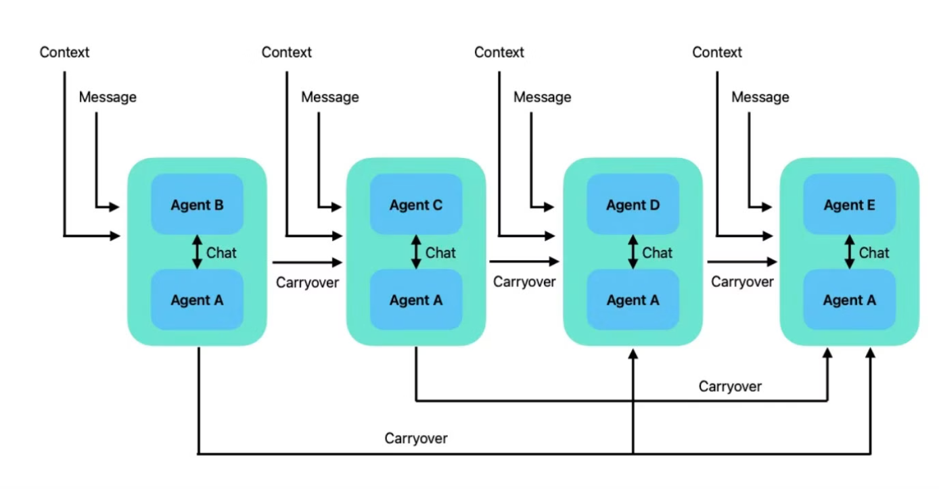
What is Sequential Chat?
In a sequential conversation pattern, an agent starts a two-agent chat, and then the chat summary is carried forward to the next two-agent chat. In this way, the conversation follows a sequence of two-agent chats.

Slide 30
What are the limitations of AutoGen?
Data Biases: Large language models, trained on extensive data, can inadvertently carry biases present in the source data. Consequently, the models may generate outputs that could be potentially biased or unfair.
Lack of Contextual Understanding: Despite their impressive capabilities in language understanding and generation, these models exhibit limited real-world understanding, resulting in potential inaccuracies or nonsensical responses.
Lack of Transparency: Due to the complexity and size, large language models can act as `black boxes,' making it difficult to comprehend the rationale behind specific outputs or decisions.
Content Harms: There are various types of content harms that large language models can cause. It is important to be aware of them when using these models, and to take actions to prevent them. It is recommended to leverage various content moderation services provided by different companies and institutions.
Inaccurate or ungrounded content: It is important to be aware and cautious not to entirely rely on a given language model for critical decisions or information that might have deep impact as it is not obvious how to prevent these models to fabricate content without high authority input sources.

Slide 31
PDF Summarizer Project - Overview
A FastAPI-based application that extracts text from PDFs and generates summaries using Google Gemini. The project supports real-time WebSocket communication and allows users to provide feedback for refined summaries.

Slide 32
⚙️ Tech Stack Used
Backend: FastAPI, Python
LLM: Google Gemini API (via autogen)
Text Extraction: pdfplumber, PyPDF2
WebSocket Communication: FastAPI WebSockets
Orchestration: Autogen framework

Slide 33
🔄 Workflow Summary
1️⃣ User uploads a PDF (via WebSocket). 2️⃣ Extract text using pdfplumber and PyPDF2. 3️⃣ Send extracted text to Gemini for summarization. 4️⃣ Receive and display the summary. 5️⃣ User provides feedback (YES/NO). 6️⃣ If NO ➝ Refine summary based on user input.

Slide 34
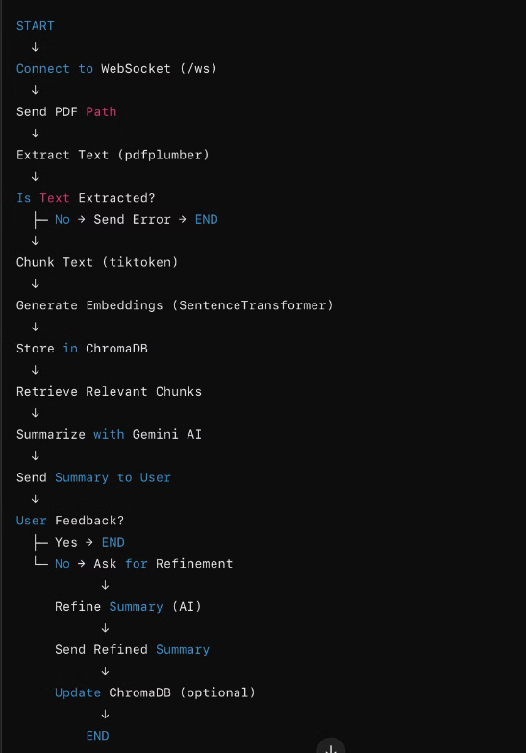
📊 Flowchart (Text-Based Representation)

Slide 35
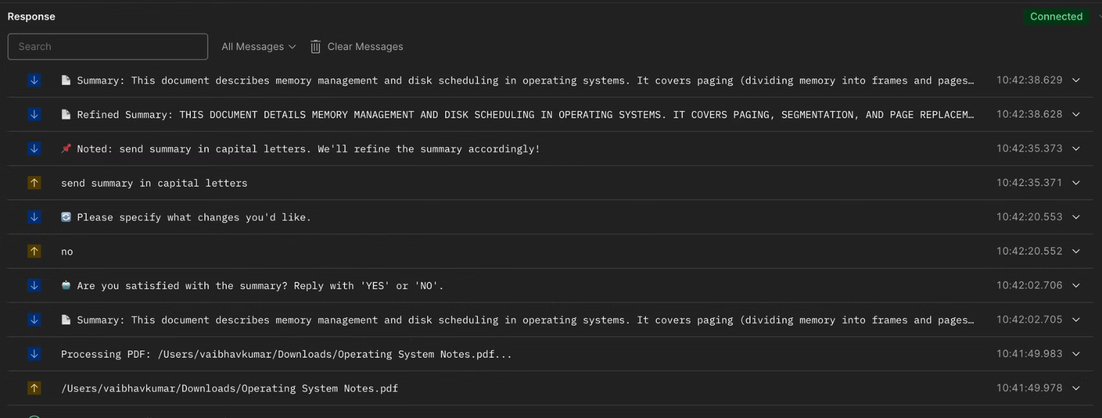
Websocket result:

Slide 36

Conclusion
AutoGen’s conversation patterns, like sequential, allow us to build complex, multi-agent interactions beyond standard two-person chats. These patterns enable seamless task coordination, breaking down complex workflows into manageable steps handled by specialized agents. With AutoGen, applications across finance, content generation, and customer support can benefit from enhanced collaboration among agents. This enables us to create adaptive, efficient conversational solutions tailored to specific needs.

